Slide 1
UCLA CS174A (Winter 2024) Introduction to Computer Graphics
University of California, Los Angeles
https://bruinlearn.ucla.edu/courses/176723
Prof. Asish Law
TAs: Junlan, Benet

Slide 2
Instructor & TAs
Name | Asish Law | Junlan Lu (A,C) | Benet Oriol Sabat (B,D)
Role | Instructor | TA | TA
Email | alaw@cs.ucla.edu | jlu21@cs.ucla.edu | benet@cs.ucla.edu
Phone | 626.379.3377 | NA | NA
Class Location | Boelter 3400 | Haines A25, Rolfe 3126 | PUB AFF 2250, Royce 162
Class Hours | TR 6-8 PM | F Noon-2 PM, F 2-4 PM | F Noon-2 PM, F 2-4 PM
Office Location | Classroom | Zoom | Zoom
Office Hours | TR 8:00-8:30PM | R 2-4 PM | T 1-3 PM

Slide 3
My Background
1992-1996: Teaching Assistant and Course Coordinator
1996: PhD in CS from tOSU, specialized in 3D Volume Rendering
1996-1999: moved to LA in 3D gaming/animation industry
1998: joined UCLA to initiate CS174A
1998-2004: taught 3D CG at UCLA and USC
2019: returned to UCLA to teach CS174A
Other Educational Areas:
High school STEM tutor
Course designs: AI in Education, Innovating Education, NLP
Keynote speaker: AI & Other Innovations in Educaiton

Slide 4
Teaching Protocol
Fully online using Zoom, including office hours
Do not share zoom link
Keep yourself muted at all times unless you want to ask a question
No need to turn on your camera
Follow all other zoom class protocols
Hybrid media, switching between:
Slides: using Powerpoint on my Windows laptop
Whiteboard: using Notability on my iPad
Zoom Chat: students are free to chat and post questions in chat box

Slide 5
Teaching Protocol (Contd.)
All zoom lectures will be recorded and posted in BruinLearn
IMPORTANT: Any time you realize that I forgot to start recording the lecture, PLEASE remind me
Interact during class: raise hand, use chat, no in-class polling
Post-lecture hangout: 10-15 mins

Slide 6
Contact Protocol
We expect you to use the course forum (BruinLearn)
Good for questions and answers
Dissemination of information, assignments, etc.
Try to keep emails for class related personal matters
If you ask about assignments, etc. we will likely redirect you to forum

Slide 7
Exam Protocol (if ZOOM)
Fully online on Zoom
All cameras must be turned on
Scan and upload in Gradescope
We will mockup an end-to-end quiz during TA session

Slide 8
Purpose of Class
Active learning and PBL (project based learning)
Learn basic computer graphics and interaction
Opportunity to use all of your CS skills
Opportunity to use your high-school math
Help each other, learn how to work in a team
HAVE FUN!
More details in syllabus

Slide 9
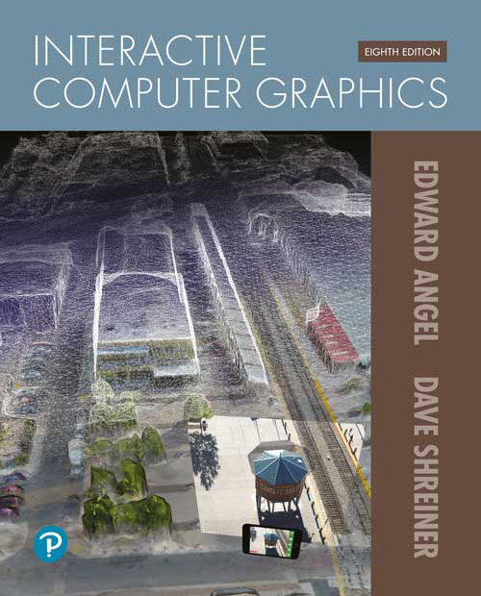
Textbook (Optional)
Interactive Computer Graphics – A Top-Down Approach with WebGL
E-Text only
Edition 8e, Angel & Shreiner
ISBN-13: 978-0135258262
Pearson E-Book

Slide 10
Textbook: Sample Exercises

Slide 11
Textbook
Textbooks are expensive
Ask on Canvas
Only loosely going to follow this book
Our methodology will diverge quickly
Otherwise this class will mostly follow the usual progression
Many lecture slides have stood the test of time
Some we’ll skip to make room for hands-on demos

Slide 12
Course Administration
Five project assignments
Last one is an open ended group project
Others are to build skills for that one
25% penalty for each day late submission
Grading breakdown (500 pts):
4 individual projects (0+25+25+25): 75 pts
1 team project: 150 pts
25 quizzes: 25 pts
1 midterm exam: 100 pts
1 final exam: 150 pts

Slide 13
Course Administration (contd.)
Exam format: freeform, not multiple choice, math-heavy
Curving final grades up or down is not ruled out, if needed to move the distribution so that grades are not too uniform or too low
Besides that, final grades will be awarded as follows:
D-: 60%+, D: 63%+, D+: 67%+, C-: 70%+, C: 73%+, C+: 77%+, B-: 80%+, B: 83%+, B+: 87%+, A-: 90%+, A: 93%+, A+: 97%+
PNP option: https://www.seasoasa.ucla.edu/deadlines-enrollment-policies/

Slide 14
Quizzes
Purpose is to gauge class attendance and attention
1-2 questions per class on material covered during lecture
You will have 60 seconds to respond to a question
Correct answer: 1 pt, incorrect answer: 0.5 pt, no answer: 0 pt
Total quiz points in quarter: 25
Question will be presented in classroom, respond on Canvas
Log into Canvas on your device when you arrive to class
Top 25 quiz scores will impact your final grade

Slide 15
Programming Assignments
JavaScript, HTML/CSS, tiny-graphics are used in this class
If you don’t know these, you will by the end
You’ll even see TAs use them on the screen
Learn to use debuggers (we will not debug for you)

Slide 16
Programming Assignments
Production software off limits - let’s make our own
Libraries - only our small helper code is permitted for most assignments
For team project, outside code won't count towards grade or impressiveness

Slide 17
Team Project (150 points)
Team sizes 3-4
Expectations scale with size
Preliminary proposal: 25 points
Final proposal & midway evaluation: 25 points
Final demo & report: 75 points
Peer evaluation: 25 points

Slide 18
Team Project: Peer Evaluations
Uses flipped-classroom and gamification paradigms
Objective: analysis, synthesis, evaluation
Evaluate 2-3 other projects
TAs will provide evaluation criteria
Team’s grade will be average of all peer evaluations

Slide 19
Team Project
Project based learning
You get to make something!
Show off!
Be proud of it
Put it on your resume
But it was a team effort?
So far that’s been the effective part!
Congratulatory Video Spring 2020

Slide 20
Individual Assignment Examples
Done by one person
Done using only:
Plain JavaScript
Low level math
Pixel operations
Some 2D image files
An understanding of 3D techniques

Slide 21
TA Sessions
Primarily to discuss project assignments: JavaScript, project, tiny-graphics, etc.
Occasionally for more detail (linear algebra)
Deeper dives into specific topics from class
Additional math examples
Q&A, homework help

Slide 22
TA Session This Week
Following topics are on TA Session agenda:
Walkthrough of Discussion and how the class intends to use it
Assignment #1
Introduction to JavaScript, WebGL & tiny-graphics library
Grading criteria for projects: individual and team
Intro to linear algebra and matrices

Slide 23
Mathematics of Computer Graphics
Linear (vector/matrix) algebra
Coordinate systems
Geometry
Points, lines, planes
Affine transformations
Projection transformations
More geometry
Curves, surfaces

Slide 24
Typical Comments From Prior Quarters
A lot of math, material, programming, fun
Disconnect between theory and assignments, out of sync with each other; assignments are to reinforce concepts taught in class rather than to implement them
Exam examples not covered in class, what will we be tested on
Team project not explained sufficiently
More project discussions than conceptual/theoretical stuff
Not for modelers or artists

Slide 25
Remember:
Come to class and Friday discussions (in-person)
Manage your course load
Do individual work
Start assignments early
Get help early (on Canvas and in TA sessions)

Slide 26
Remember
If you:
Do the Assignments
Take the Exams
Complete the Term Project
…you should be able to do just fine
Extra stuff is for those of you who
Want to challenge yourself (or show off)
Have some extra fun
Something cool to show during interviews…

Slide 27
Detailed Class Schedule
See Syllabus posted in Canvas

Slide 28
Online Class Etiquette
An Etiquette Guide to Remote Classroom
Raise your hand while asking questions, lower when done
Behave as if you’re in a physical classroom: dress and act accordingly
Academic integrity is academic integrity whether you are on campus or learning remotely. Take your exams following the rules set out for particular classes. If you are taking a test that asks you not to use notes or outside resources, don’t. Others will be following the rules and your decision is violating campus and community norms.
Quick Guide to Online Etiquette

Slide 29
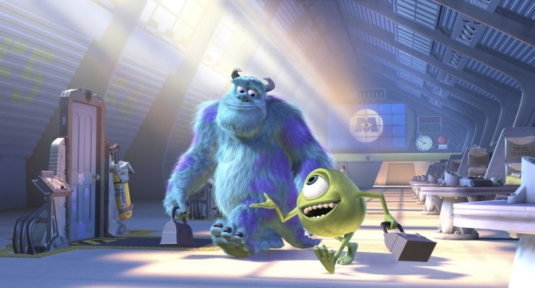
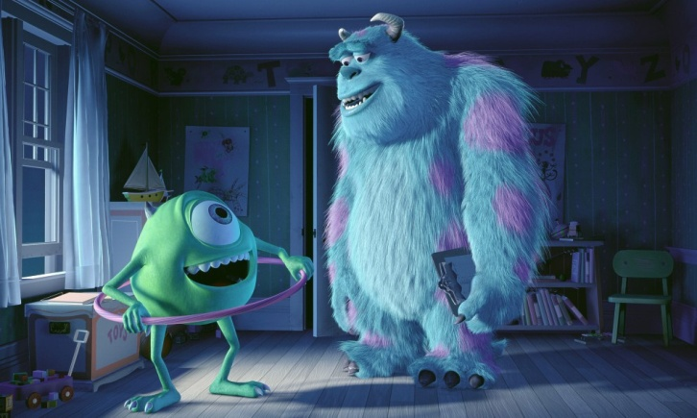
Computer Graphics
The Art and Science of creating imagery by computer
Art
Mathematics
Physics
Vision
Engineering
Optics
Artificial Intelligence
Biomechanics
Notes:
Physics: Natural phenomena, wave theory
Mechanics: fluid mechanics, articulated body mechanics
Optics: camera and lens models
Biomechanics: human motion
AI: human behaviors, learning of motor tasks
Engineering: Control theory, robotics

Slide 30
Applications of CG
Entertainment
Films
Computer games
Virtual reality
Visualization
Scientific visualization
Medical visualization
Flight simulation
Architecture
Education, etc.

Slide 31
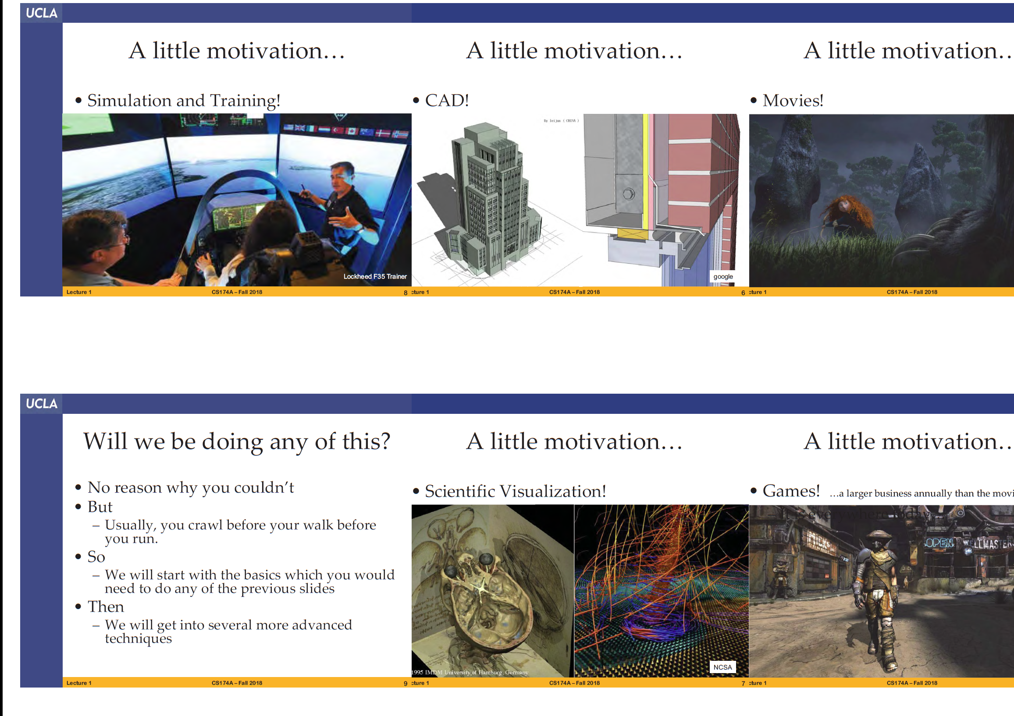
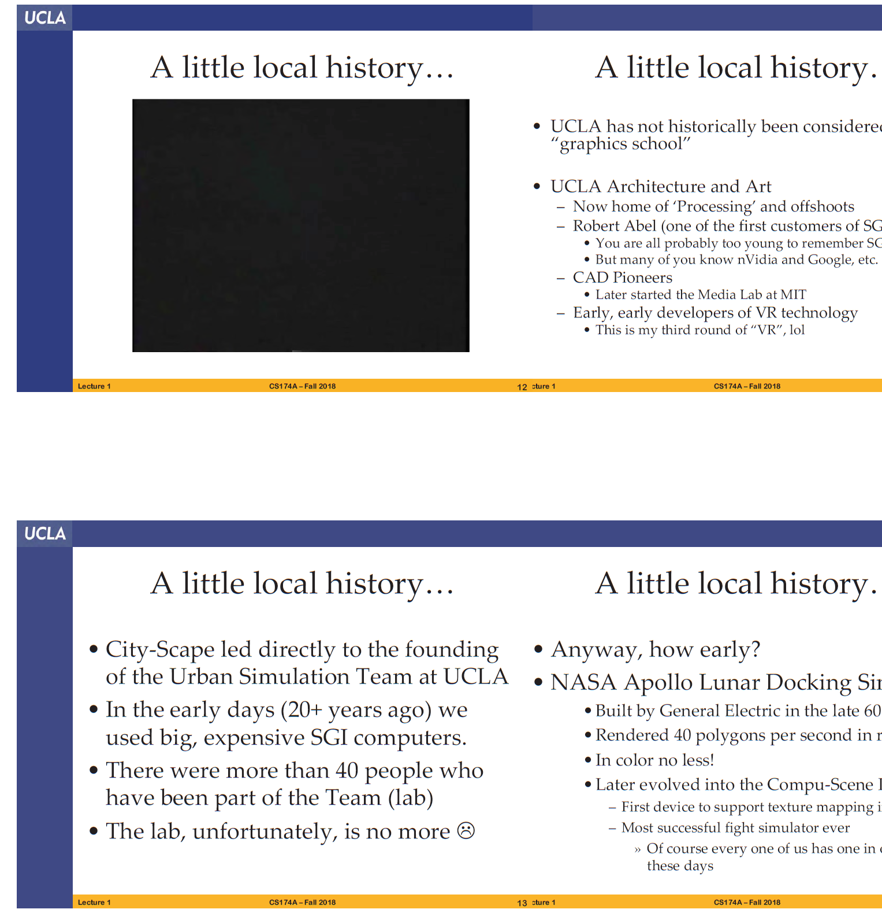
Motivation/local history

Slide 32
History
2000 B.C.
orthographic projection
1400s
Perspective: Italian Renaissance
1600s
coordinate systems: Descartes
optics: Huygens
optics, calculus, physics: Newton

Slide 33
History
1897 oscilloscope: Braun
1950-1970
computers with vector displays
1966
first true raster display
1993
1200x1200, 500k triangles/sec, 36-bit color, stereo, texture mapping… all at 60Hz
1995
feature-length CG films
Today…still rapidly evolving

Slide 34
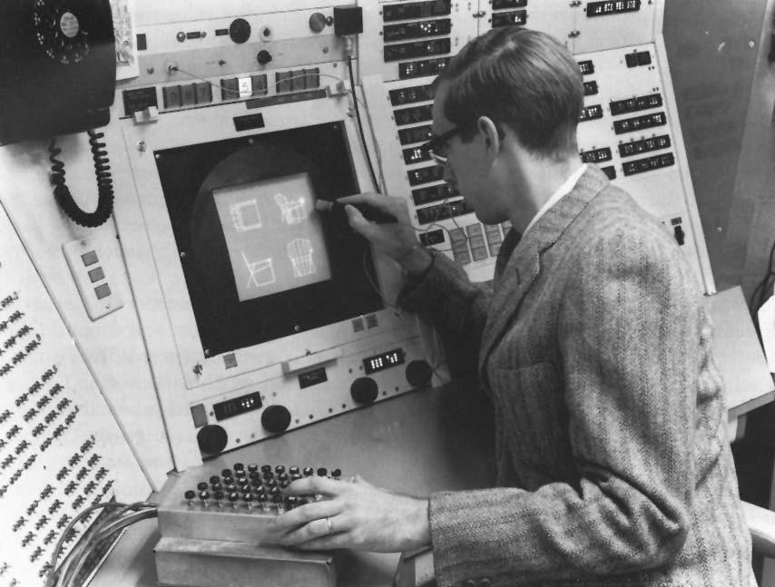
Genesis of Computer Graphics and Interactive Techniques
A PhD project at MIT in the early 1960s
Ivan E. Sutherland, 1963
“Sketchpad, a man-machine graphical communication system”

Slide 35
Trivia
When was the term “Computer Graphics” first stated?
William Fetter of Boeing coins the term "computer graphics" for his human factors cockpit drawings 1960
When was the Graphical User Interface developed?
GUI developed by Xerox (Alan Kay) 1969
When was Tron released?
Disney contracts Abel, III, MAGI and DE to create computer graphics for the movie Tron released in 1981

Slide 36
Trivia
Which was the first animated movie to employ CG?
“The Great Mouse Detective” (1986) was the first animated film to be aided by CG
When was the game “Doom” released?
1993
Which are the best selling games of all time?
Minecraft, Grand Theft, Tetris

Slide 37
Trivia
Which are some of latest CG animated movies?
Elemental, Minion 3D, Encanto, Onward, Frozen 2, Lion King, Raya and the Last Dragon, Vivo, Luca
Which is bigger in terms of gross revenue, the game industry or the (Hollywood) movie industry?
The game industry
Movies nominated at Oscars 2023:
Turning Red, Puss in Boots: The Last Wish, Pinocchio, The Sea Beast, Marcel The Shell With Shoes On

Slide 38
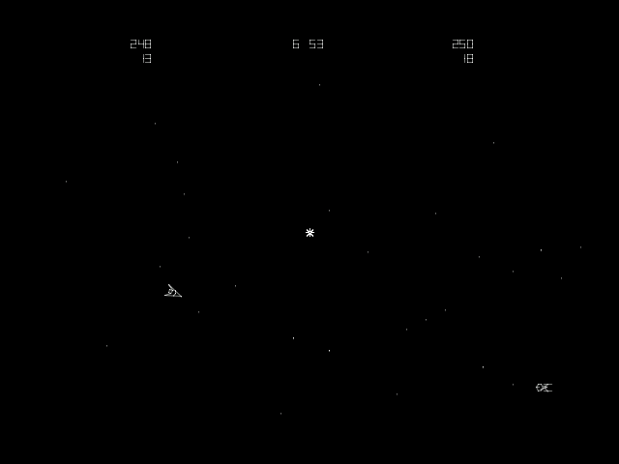
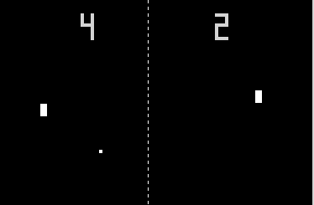
The First Computer Game?
Pong, Atari, 1972
Spacewars, PDP–1, MIT, 1961

Slide 39
The First “Computer” Game – 1958 !!
“Tennis for Two”
https://www.youtube.com/watch?v=s2E9iSQfGdg

Slide 40
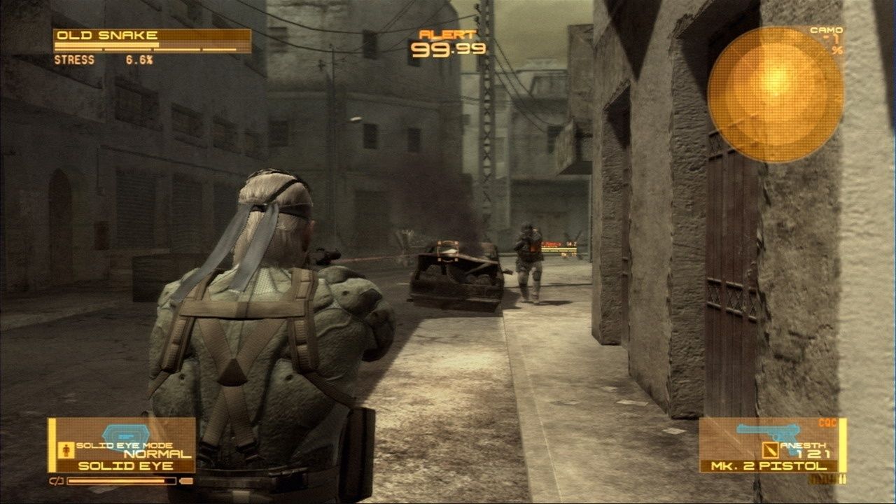
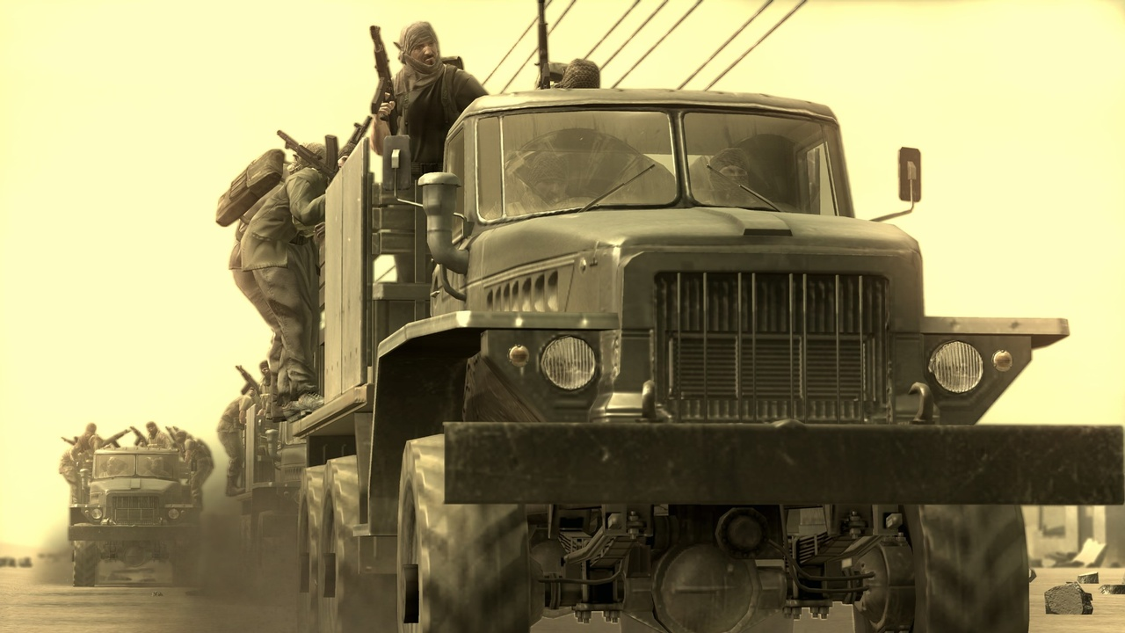
Metal Gear Solid 4

Slide 41
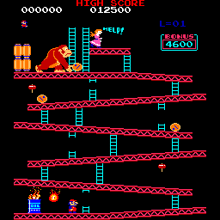

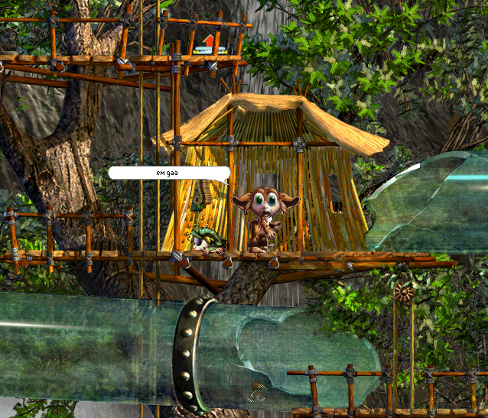
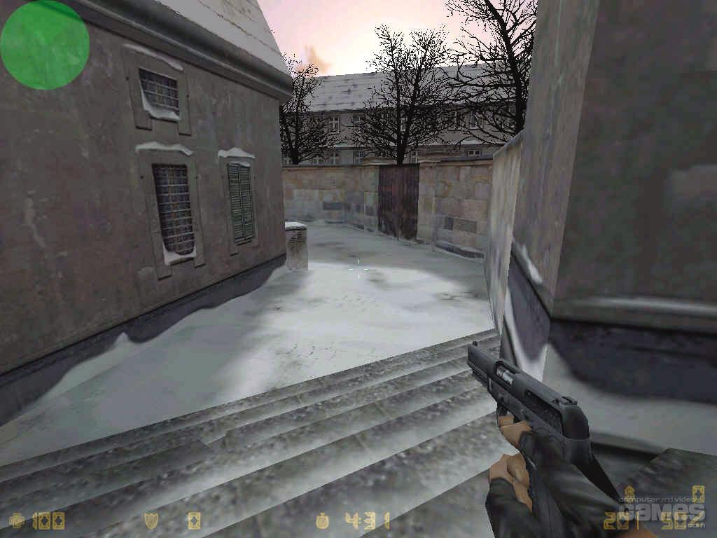
Games
Focus on interactivity

Slide 42
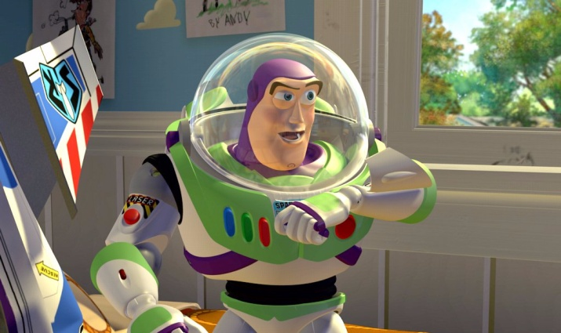
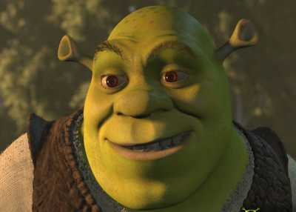
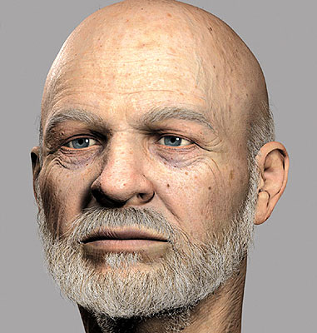
Movies
To reality and beyond !

Slide 43

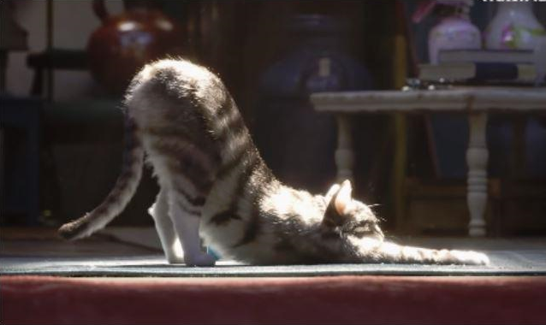
Movies
Toy Story 1 (1995) Toy Story 4 (2019)

Slide 44
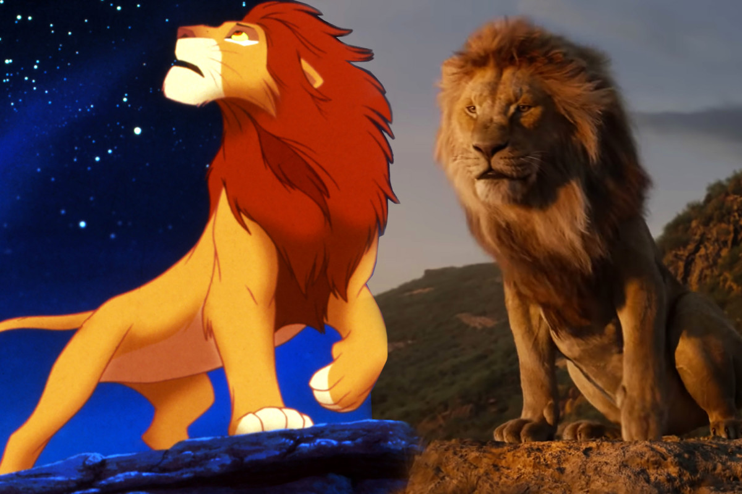
Movies
Lion King: 1994 vs. 2019

Slide 45
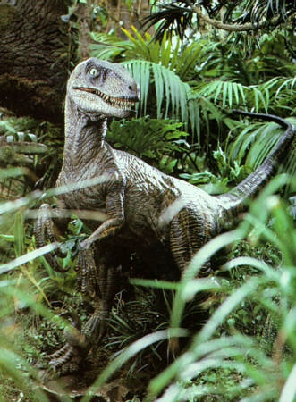
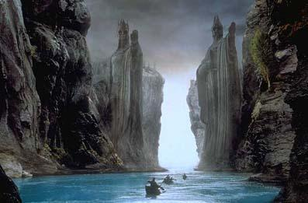
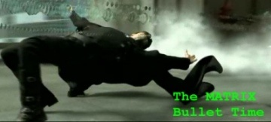
Movies
Special effects

Slide 46

Movies

Slide 47
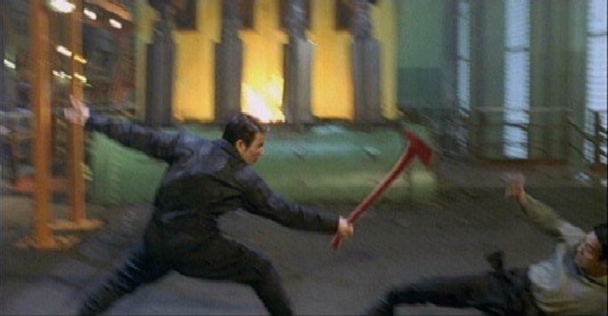
Digital Compositing

Slide 48
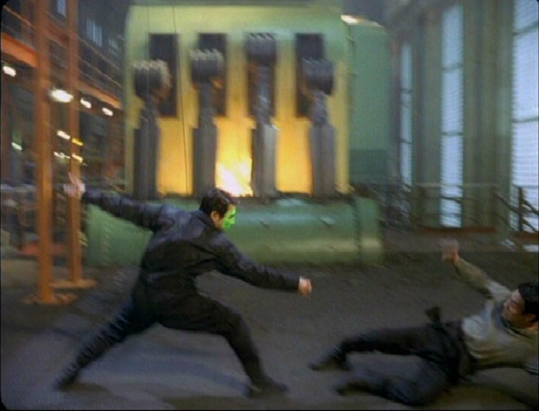
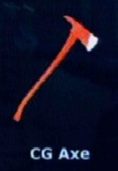
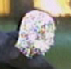
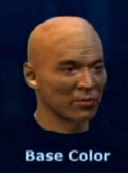

Slide 49
Digital Compositing

Slide 50
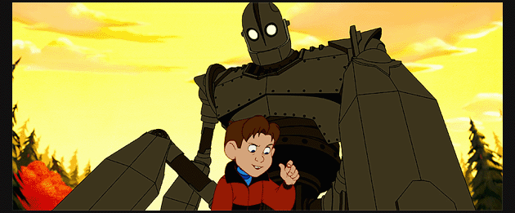
Cartoons

Slide 51
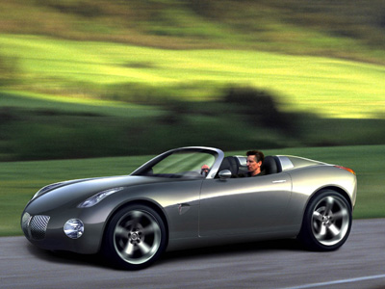
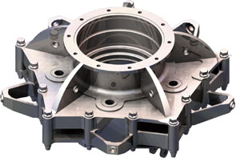
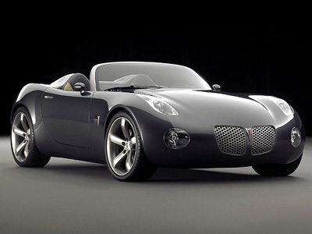
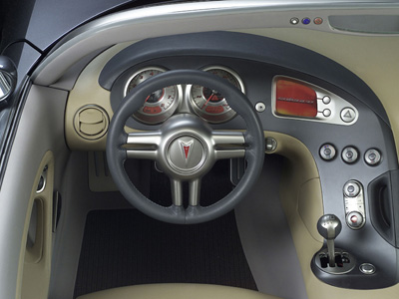
Computer-Aided Design
Precision modeling
Engineering visualization

Slide 52
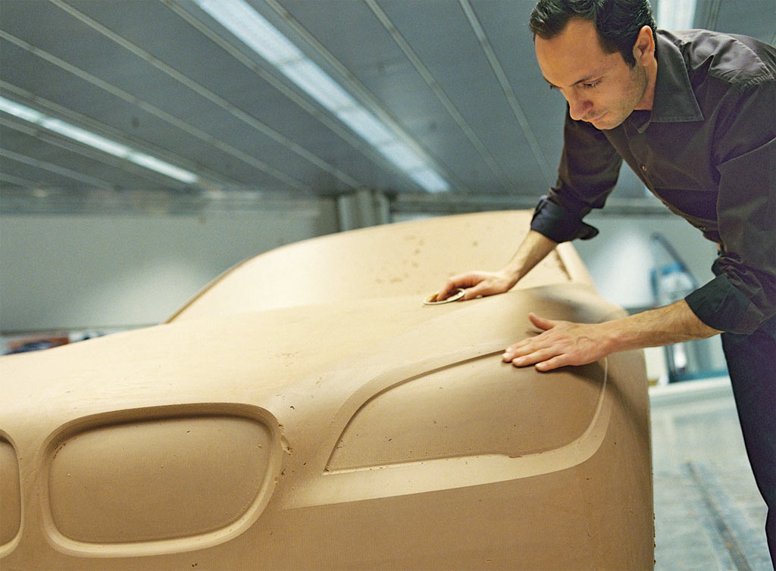
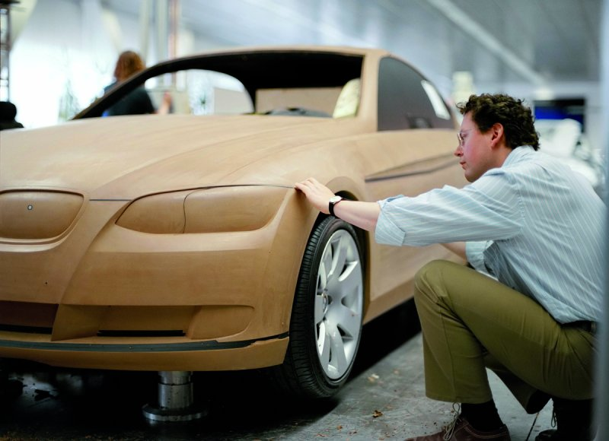
Modeling Clay

Slide 53
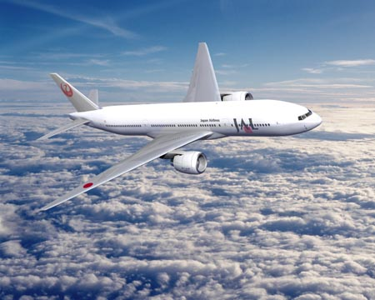
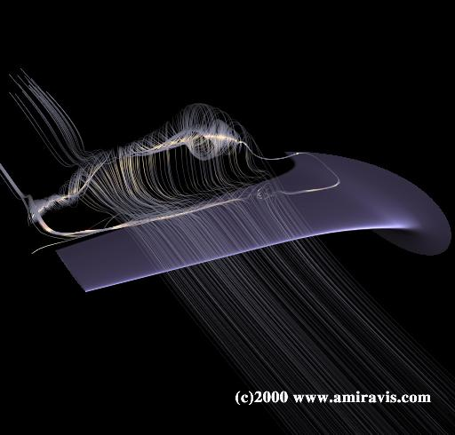
Computer-Aided Design
It’s not just about visualization
Simulation is also useful

Slide 54
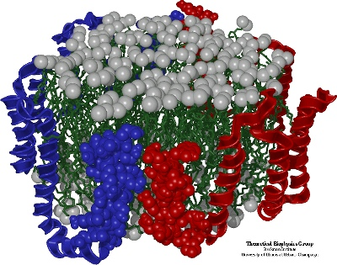
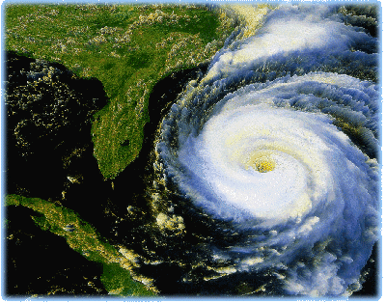
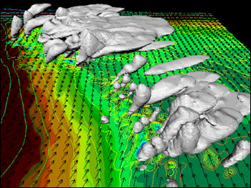
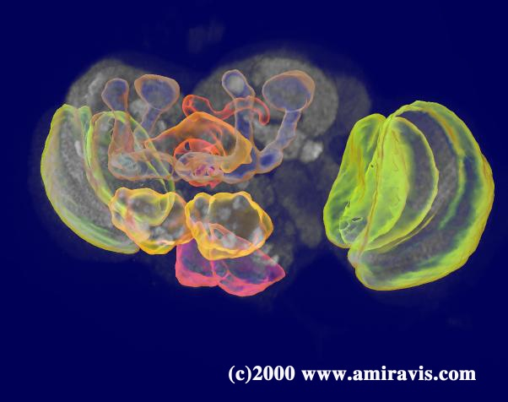
Visualization: Scientific
Molecular Biology
Environmental Physics

Slide 55

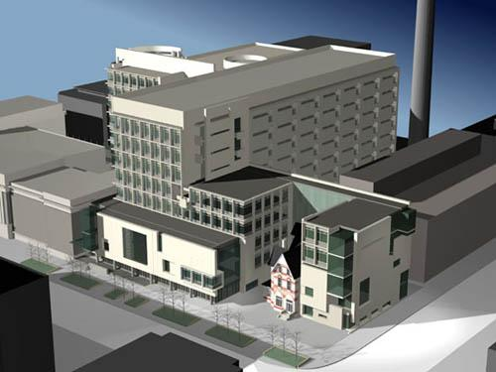
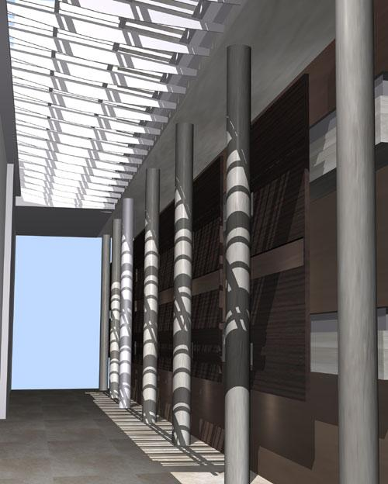
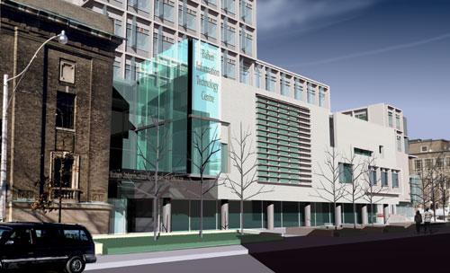
Visualization: Architectural
http://www.diamondschmitt.com/

Slide 56
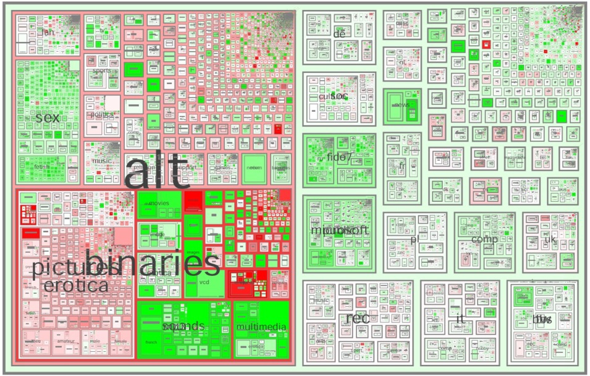
Visualization: Info
Smith and Fiore

Slide 57
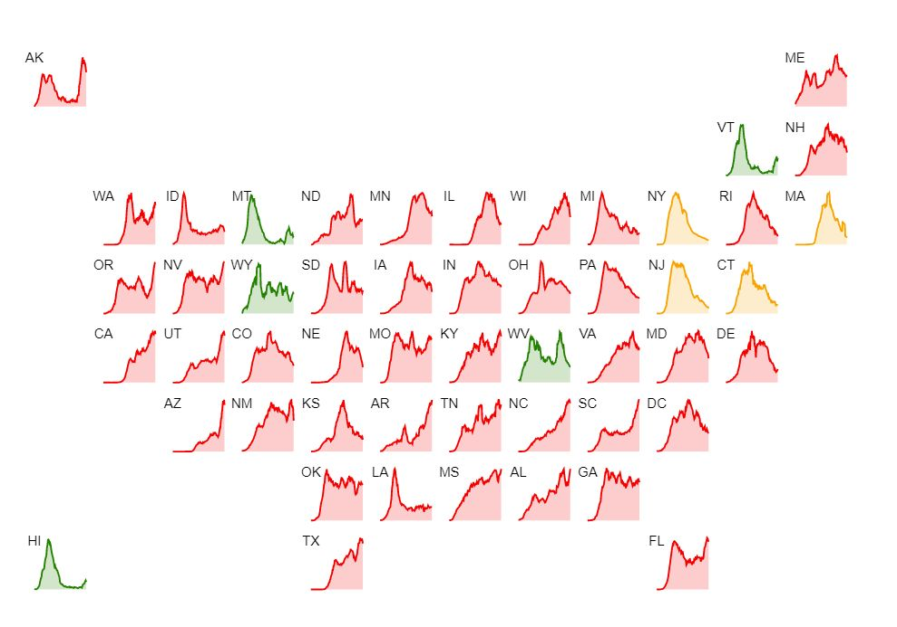
Visualization: Info (Covid Tracker)

Slide 58
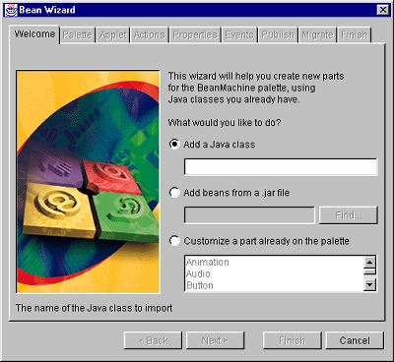
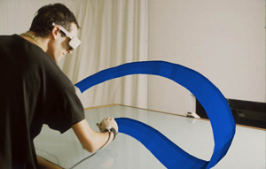
Graphical User Interfaces
Steven Schkolne
WIMP

Slide 59
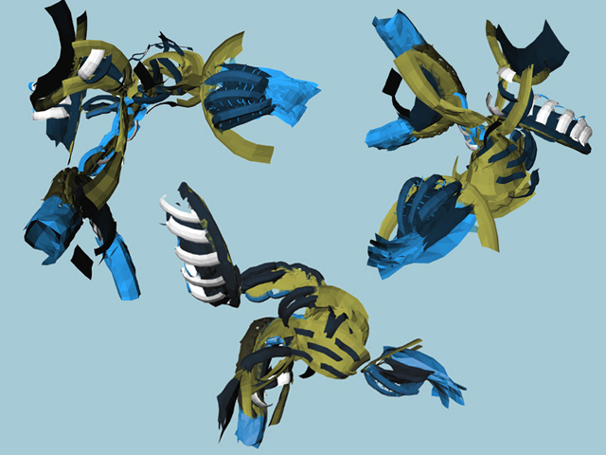
Art
Steven Schkolne

Slide 60
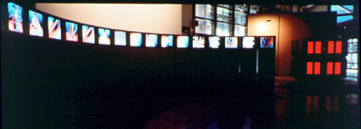
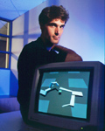
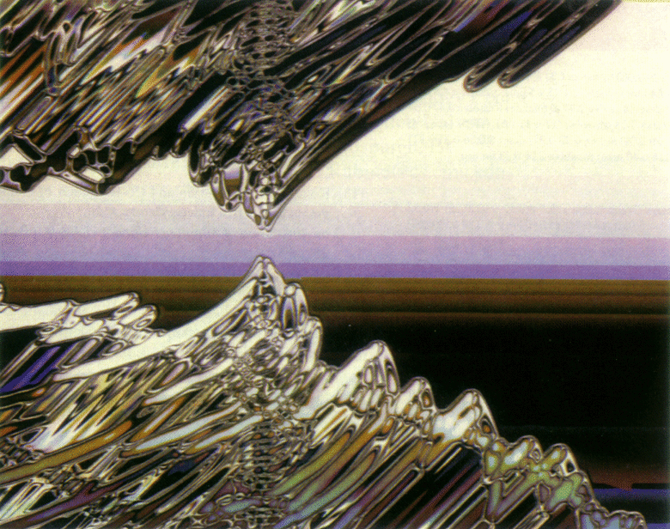





Digital Art
Genetically evolved
Carl Sims

Slide 61

Digital Art
By Jason Salavon
“Titanic”
The Top-Grossing Film of All Time
^
2nd

Slide 62

Basic Elements
Modeling
Animation
Rendering
Interaction

Slide 63
Basic Elements
Modeling
How do we model (mathematically represent) objects?
How do we construct models of specific objects?
Animation
How do we represent the motions of objects?
How do we give animators control of this motion?
Rendering
How do we simulate the real-world behavior of light?
How do we simulate the formation of images?
Interaction
How do we enable humans and computers to interact?
How do we design human-computer interfaces?

Slide 64

Modeling
Primitives
3D points
3D lines and curves
Surfaces (BREPs): polygons, patches
Volumetric representations
Image-based representations
Attributes
Color, texture maps
Lighting properties
Geometric transformations

Slide 65

Modeling
Representing objects geometrically on a computer
Point clouds
Texture maps
Polygon meshes
Surface patches NURBS
Parametric curves

Slide 66





Modeling
Voxels
Alternative representations
Blobs
Subdivision surfaces

Slide 67


Modeling
Altering geometric models
Affine transform
Ying, Kristjansson, Biermann, Zorin

Slide 68


Scanning Shapes
Digital Michaelangelo Project

Slide 69

Plant Modeling

Slide 70


Plant Modeling

Slide 71


Volume Modeling
CT Scans
MRI
Ultrasound
PET Scans
Atmosphere

Slide 72


AI for Content Creation
Deep Learning for content creation
Cities
Characters
Medical data (volumes)
Synthesizing scenes from images
Geometry
Textures

Slide 73

Rendering
Visibility
Simulating light propagation
Reflection
Absorption
Scattering
Emission
Interference

Slide 74

Rendering
Illumination
Key elements
Camera
Geometric Shape
& Reflectance
Pixels

Slide 75


Camera

Slide 76



Rendering
Draw visible surfaces onto display
Camera (view direction)
Clipping
Scan Conversion
Image Plane
Camera (eye position)

Slide 77

Reflectance Modeling

Slide 78

Complex Reflectance

Slide 79

Subsurface Scattering
Translucency and varied levels of light penetration can be created using subsurface scattering effects

Slide 80

Texture
Multilevel texture synthesis

Slide 81



Non-Photorealistic Rendering
Aaron Hertzmann

Slide 82

Rendering: Information

Slide 83


Animation
Keyframe animation
Flipbook animation
Motion capture
Procedural animation
Physics-based animation
Behavioral animation
Emotion-based animation

Slide 84


Animation
Keyframe animation
Flipbook Animation
Keyframing

Slide 85








Animation
Pixar: “Luxo Jr.” (1986)

Slide 86





Animation
Motion capture
Men in Black
Avatar

Slide 87


Animating Golem in LOTR

Slide 88



Animation
The Animatrix – “Final Flight of the Osiris”

Slide 89

Animation
Example: “Geri’s Game” - Pixar

Slide 90

Cloth Simulation

Slide 91





Animation
Dynamics
Physics-based animation

Slide 92


Fluid Simulation
Modeling
Incompressibility
Viscocity
Navier-Stokes Equations
Level Sets

Slide 93


Smoke Simulation
Assumptions
No viscosity
Rendering
Photon maps
Multiple scattering

Slide 94


Animation
Behavioral animation
Ethology

Slide 95

Reality is *Very* Complex

Slide 96


Reality is *Very* Complex

Slide 97

Reality is *Very* Complex

Slide 98
Modeling Transformations
Assembly

Slide 99


Viewing
Orthographic Perspective

Slide 100
Clipping
Remove what is not visible

Slide 101
Visibility
Resolve occlusions (efficiently)

Slide 102

Illumination
Compute normals and color at vertices
Per vertex operations

Slide 103
Shading

Slide 104
Rasterization
Convert to colored pixels

Slide 105

Texture Mapping

Slide 106

Other Issues
Shadows
Participating media
Subsurface scattering
Motion blur
Camera models
Etc.

Slide 107

A Final Result

Slide 108
What is Academic about all this?
The full collection of techniques and “hacks” known to the industry? No
The history of the techniques? No
The skill of getting code working? Yes
Well-understood math concepts that separate graphics from other programming? Yes
Tying into graphics research sometimes

